Slide 1
COVID-19 Analysis
Data Engineering Platforms Final Project Presentation (Dec 12, 2020)
Jaird Meyer, Linqi Yang, Mengyang Yu, XiaoJing Zhang

Slide 2
Agenda
Executive Summary
Policy Insights
Design Considerations
Data tools
Data Collection & Source
Data Processing & Preparation
Data Storage
Data Analysis
Model Recommendation
Case Study
Tableau Dashboard
Conclusions

Slide 3
Executive Summary
Executive Summary | Policy Insights | Design Considerations | Data Tools | Conclusions
For this project, we will look at Covid-19 data in the United States, both live and historical, to assess the effectiveness of governmental policies.
Our data visualization and analysis will allow us to provide reflections on the use of data analytics in the process of tackling this challenge, as well as recommendations for future steps in preventing deaths.

Slide 4
Policy Insights
Executive Summary | Policy Insights | Design Considerations | Data Tools | Conclusions
Apply quantitative insights on policy
Find connections between real-time events to various metrics
It is important to recognize various lags when assuming time-dependent associations
Policy lag: announcement to implementation and effect
Infection lag: time of infection occurs before positive input
Quantify the effect of various policy initiatives
Takeaways
These insights will be important to implement during the continuing battle with coronavirus, but will also provide guidance for future pandemics

Slide 5
Design Considerations
Executive Summary | Policy Insights | Design Considerations | Data Tools | Conclusions
Data preparation
Aggregated data size: <1MB
Data type: structured data
Analysis granularity: county & state level
Application type
OLAP application for ease of implementation, analysis and reporting
Platform considerations
Google Cloud Platform (GCP) is compatible with MySQL and Tableau
Convenient for team members to share and transfer project data
Reliable cloud service provider choice with limited budget

Slide 6



Data Collection & Source
Executive Summary | Policy Insights | Design Considerations | Data Tools | Conclusions
Covid-19 Mask Use by State & County:
Estimates of mask usage by state & county in the United States. This data comes from a large number of interviews conducted online by the global data and survey firm Dynata at the request of The New York Times.
‘aggregated by county.csv’ Data Profile
3132 observations, 18 variables
Joined by County Key
‘covid by county.csv’
‘mask use by county.csv’
‘population by county.csv’
‘aggregated by state.csv’ Data Profile
50 observations, 38 variables
Joined by State Key
‘covid by state.csv’
‘mask use by state.csv’
‘population by state.csv’
‘health insurance by state.csv’
‘hospital utilization by state.csv’
Covid-19 Live US-States/Covid-19 Live US-Counties:
Cumulative coronavirus cases and deaths for each geography up to Nov 13th. The counts include both laboratory confirmed and probable cases using criteria developed by states and the federal government.
Annual Estimates of the Resident Population:
Annual Estimates of the Resident Population for Counties in the United States: April 1, 2010 to July 1, 2019.
Health Insurance Coverage Status and Type of Coverage:
Health Insurance Coverage Status and Type of Coverage by State All Persons: 2008 to 2019. Type of coverage includes private (employer-based and direct-purchase) and public (Medicaid, Medicare,etc).
Estimated U.S. Hospital Utilization:
Estimated hospital utilization data are available for the U.S. states, and territories. This data includes total inpatient bed, total ICU beds, percent of inpatient bed utilization, and percent of inpatients with covid, etc.

Slide 7


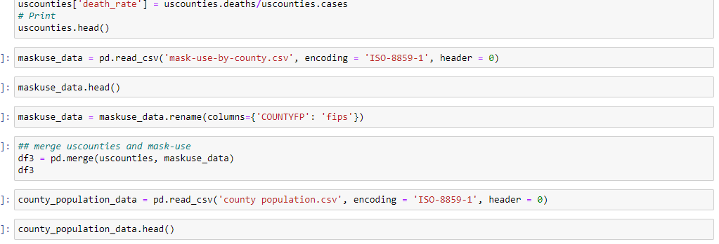
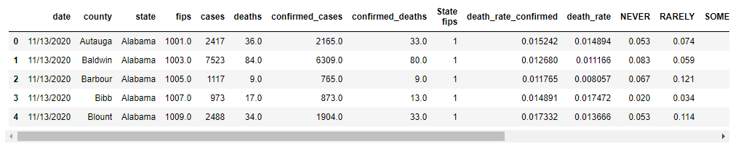
Data Processing & Preparation
Executive Summary | Policy Insights | Design Considerations | Data Tools | Conclusions
Code
Clean and preprocess
Drop duplicated columns
Drop columns w/ many NaNs
Create calculated fields for modeling
Output

Slide 8


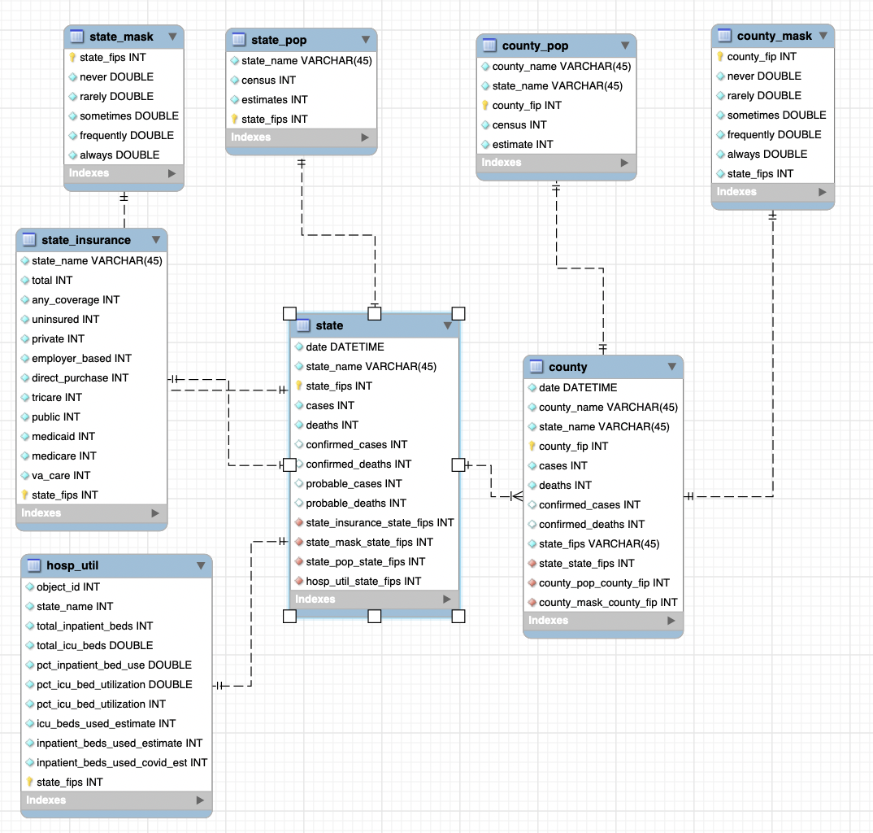
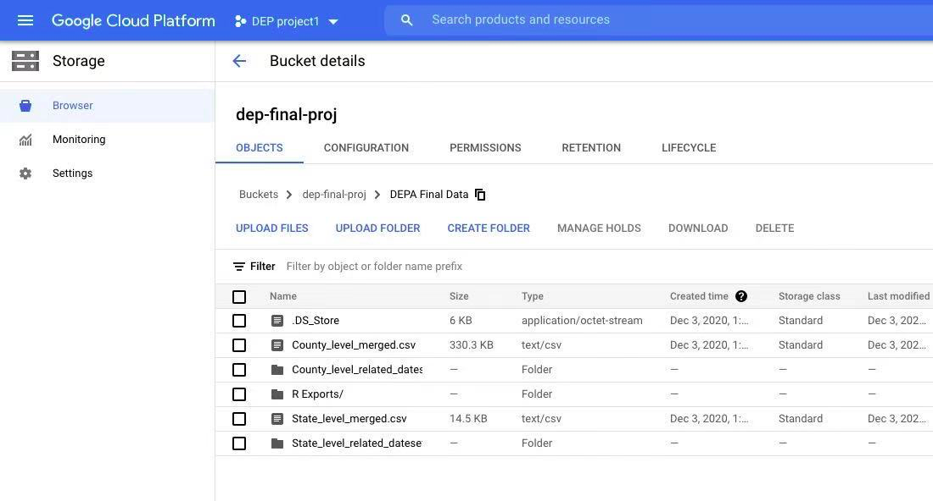
Data Storage
Executive Summary | Policy Insights | Design Considerations | Data Tools | Conclusions
Loaded data into mySQL database
Organized our data into ER diagram

Slide 9

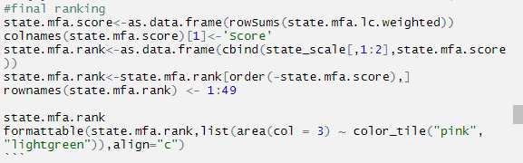
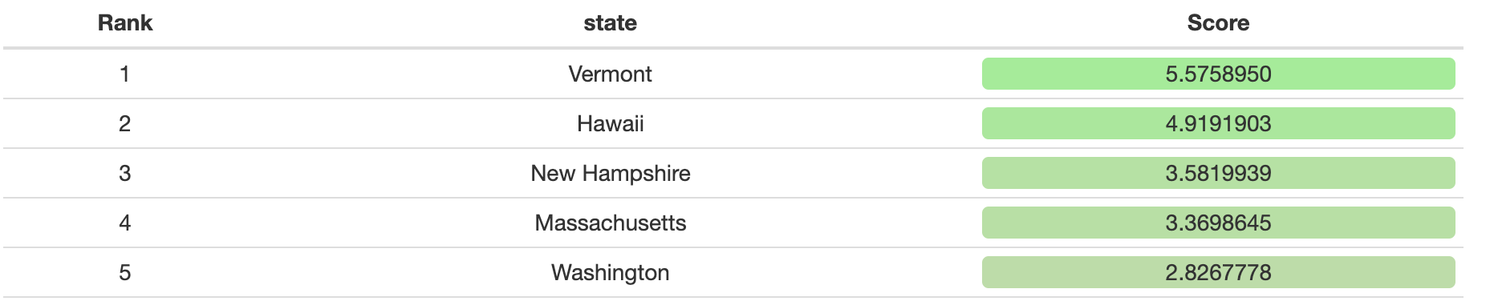
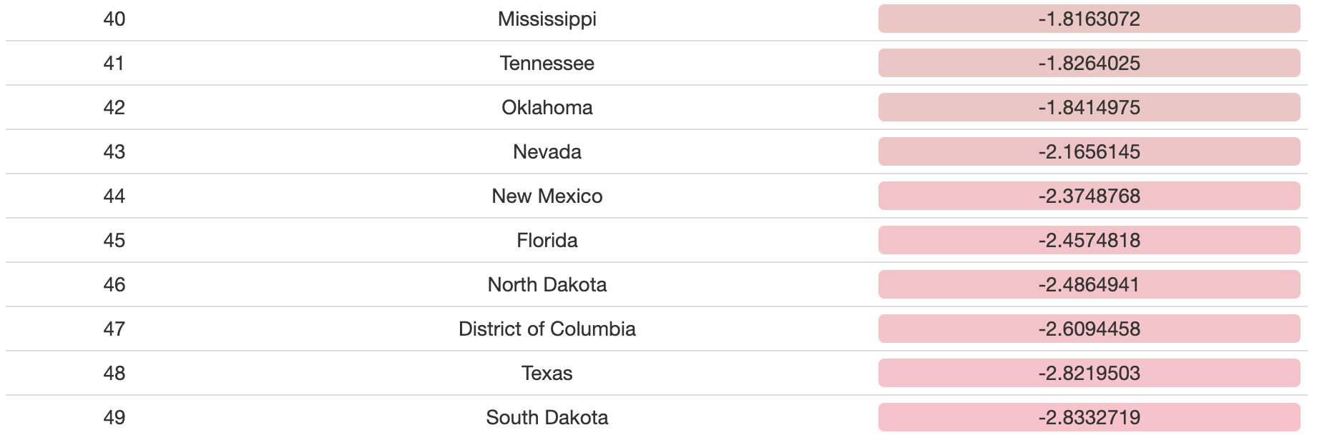
Data Analysis
Executive Summary | Policy Insights | Design Considerations | Data Tools | Conclusions
Code
Multi-Criteria Decision Analysis
Combination of PCA and MFACT
Reduce collinearity and confounding variation among variables
Rank States by the historic performance of attributes
Measure influence of each variable through weighted linear combinations
(see attached ‘Principal Component Analysis.rmd’ for more details)
Output
...

Slide 10
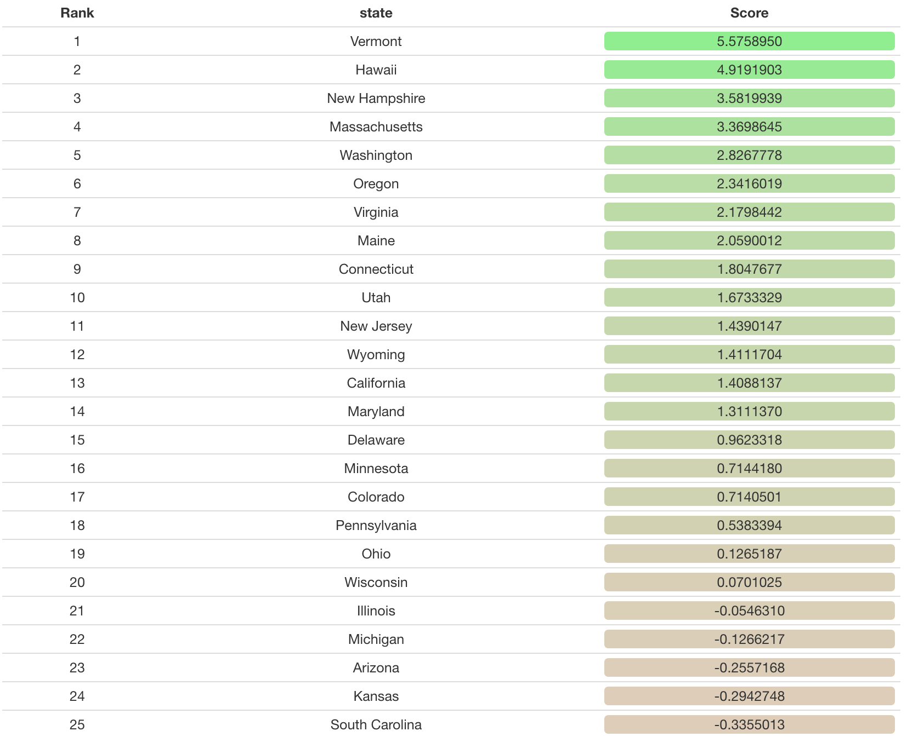
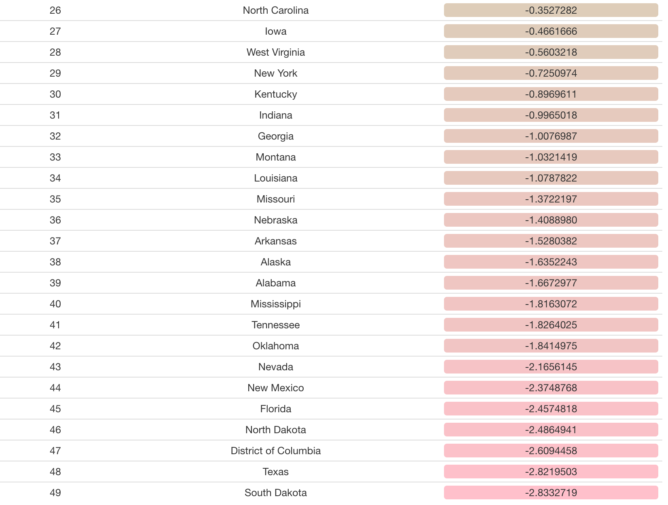
Data Output
Executive Summary | Policy Insights | Design Considerations | Data Tools | Conclusions
Output
...

Slide 11
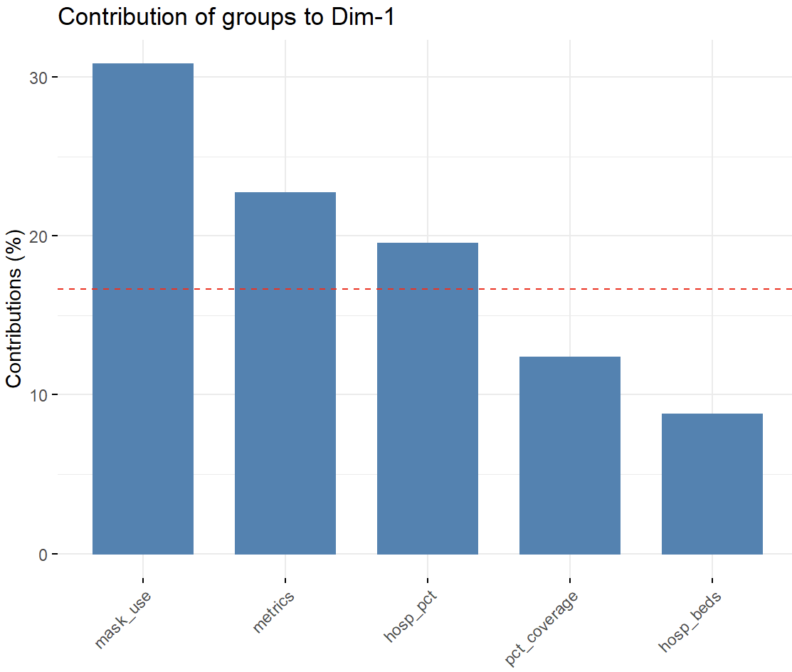
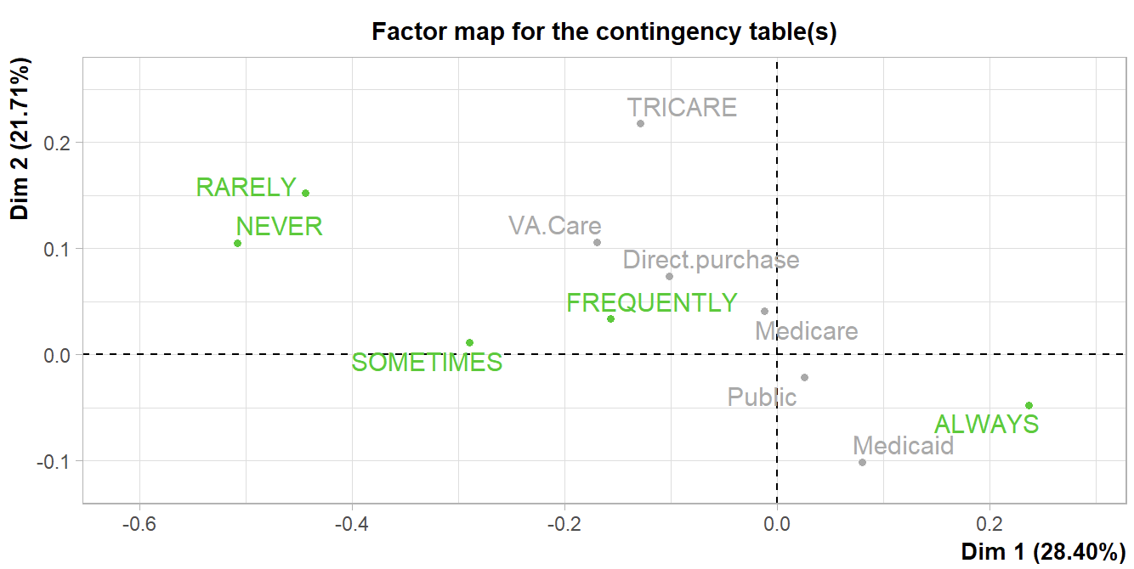
Model Recommendation
Executive Summary | Policy Insights | Design Considerations | Data Tools | Conclusions
Wear a Mask!
Model indicates masks are only effective when ALWAYS worn
Mask use has the greatest explanatory power of any group of variables in differentiating states

Slide 12
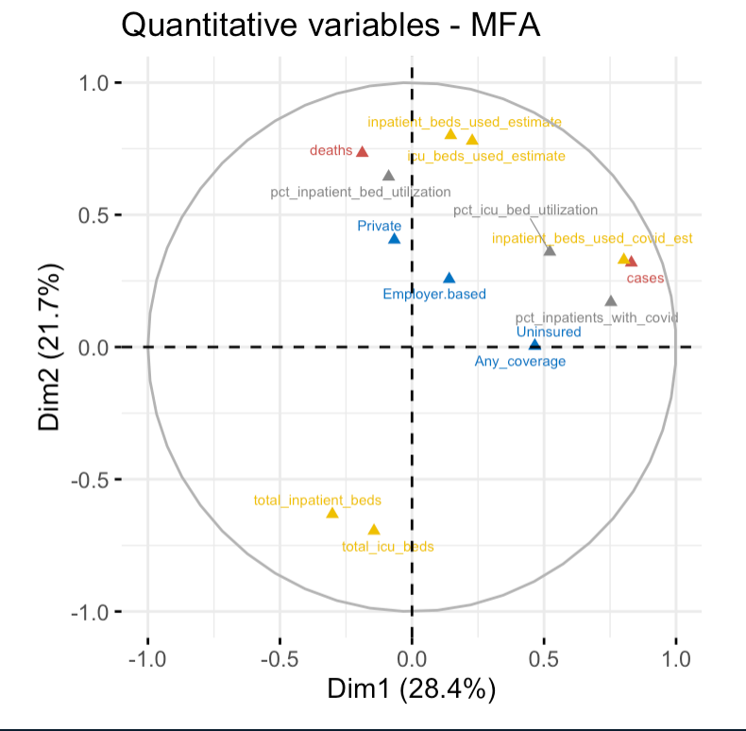
Model Recommendation
Executive Summary | Policy Insights | Design Considerations | Data Tools | Conclusions
Social Distancing
Occupancy rates in hospitals is a more significant indicator than hospital capacity
Flattening the curve is an important objective to maintain low occupancy rates

Slide 13
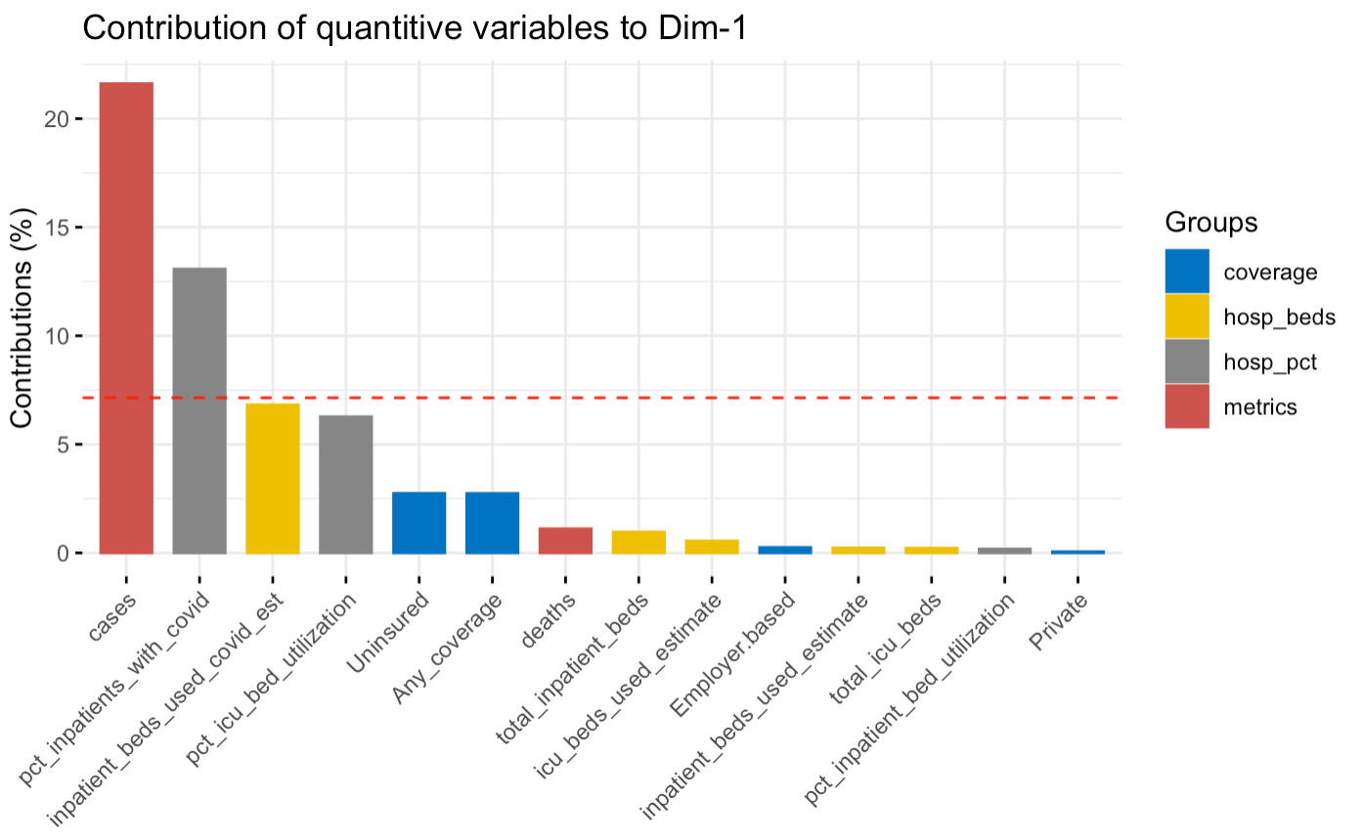
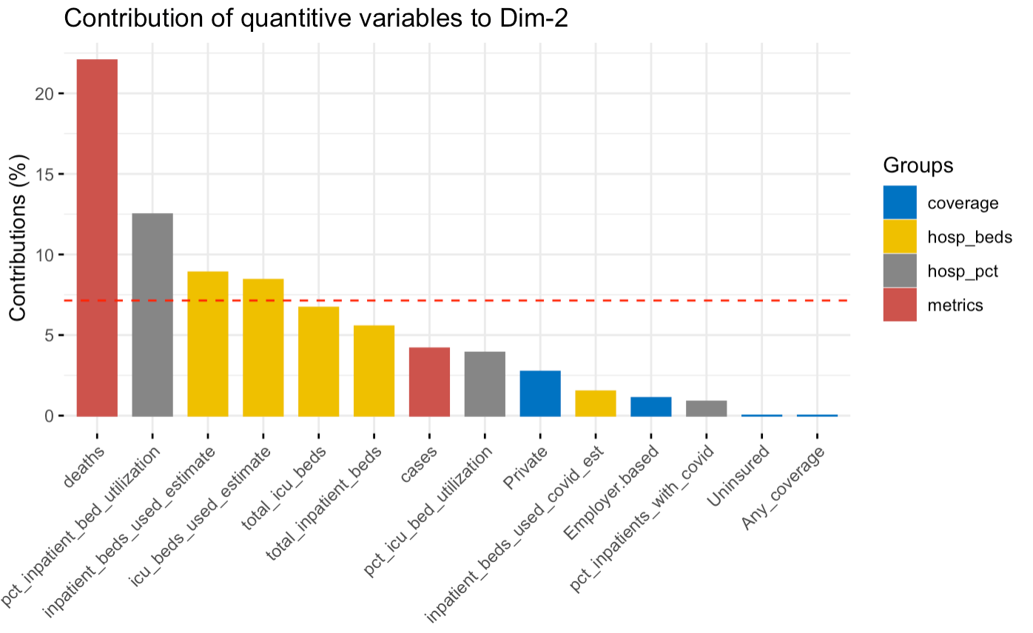
Model Recommendation
Executive Summary | Policy Insights | Design Considerations | Data Tools | Conclusions
Quantitative Dimensional Comparison
Temporal qualities of lagged variables
Dim 1 prioritizes cases and early hospital intake; Dim 2 reflects deaths and total hospital occupancy which are lagging

Slide 14
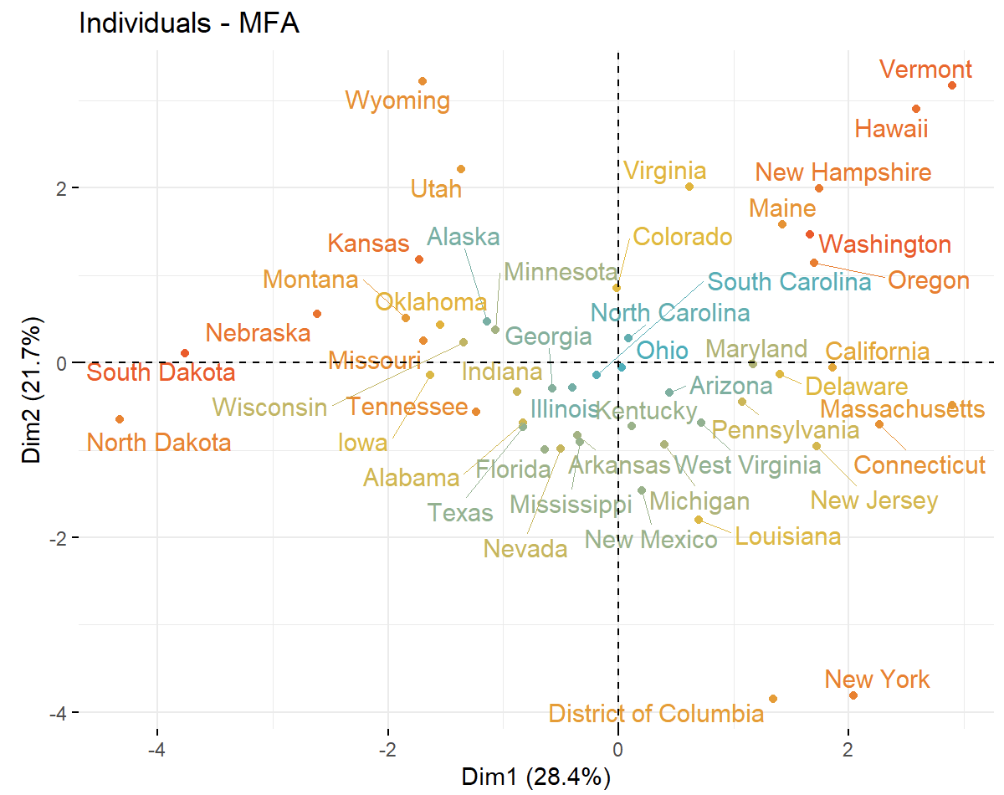
Model Recommendation
Executive Summary | Policy Insights | Design Considerations | Data Tools | Conclusions
Social Distancing
States with higher population densities tend to have higher death rates as shown along dimension 2 (possibly associated with lag in reporting)
Groups per quadrant characterize a shift in affected areas as Dim 1 reflects recent developments
Rural, less densely populated states are affected more by cases than deaths
In mid-November case counts were rapidly exploding in these regions while deaths are lagged

Slide 15
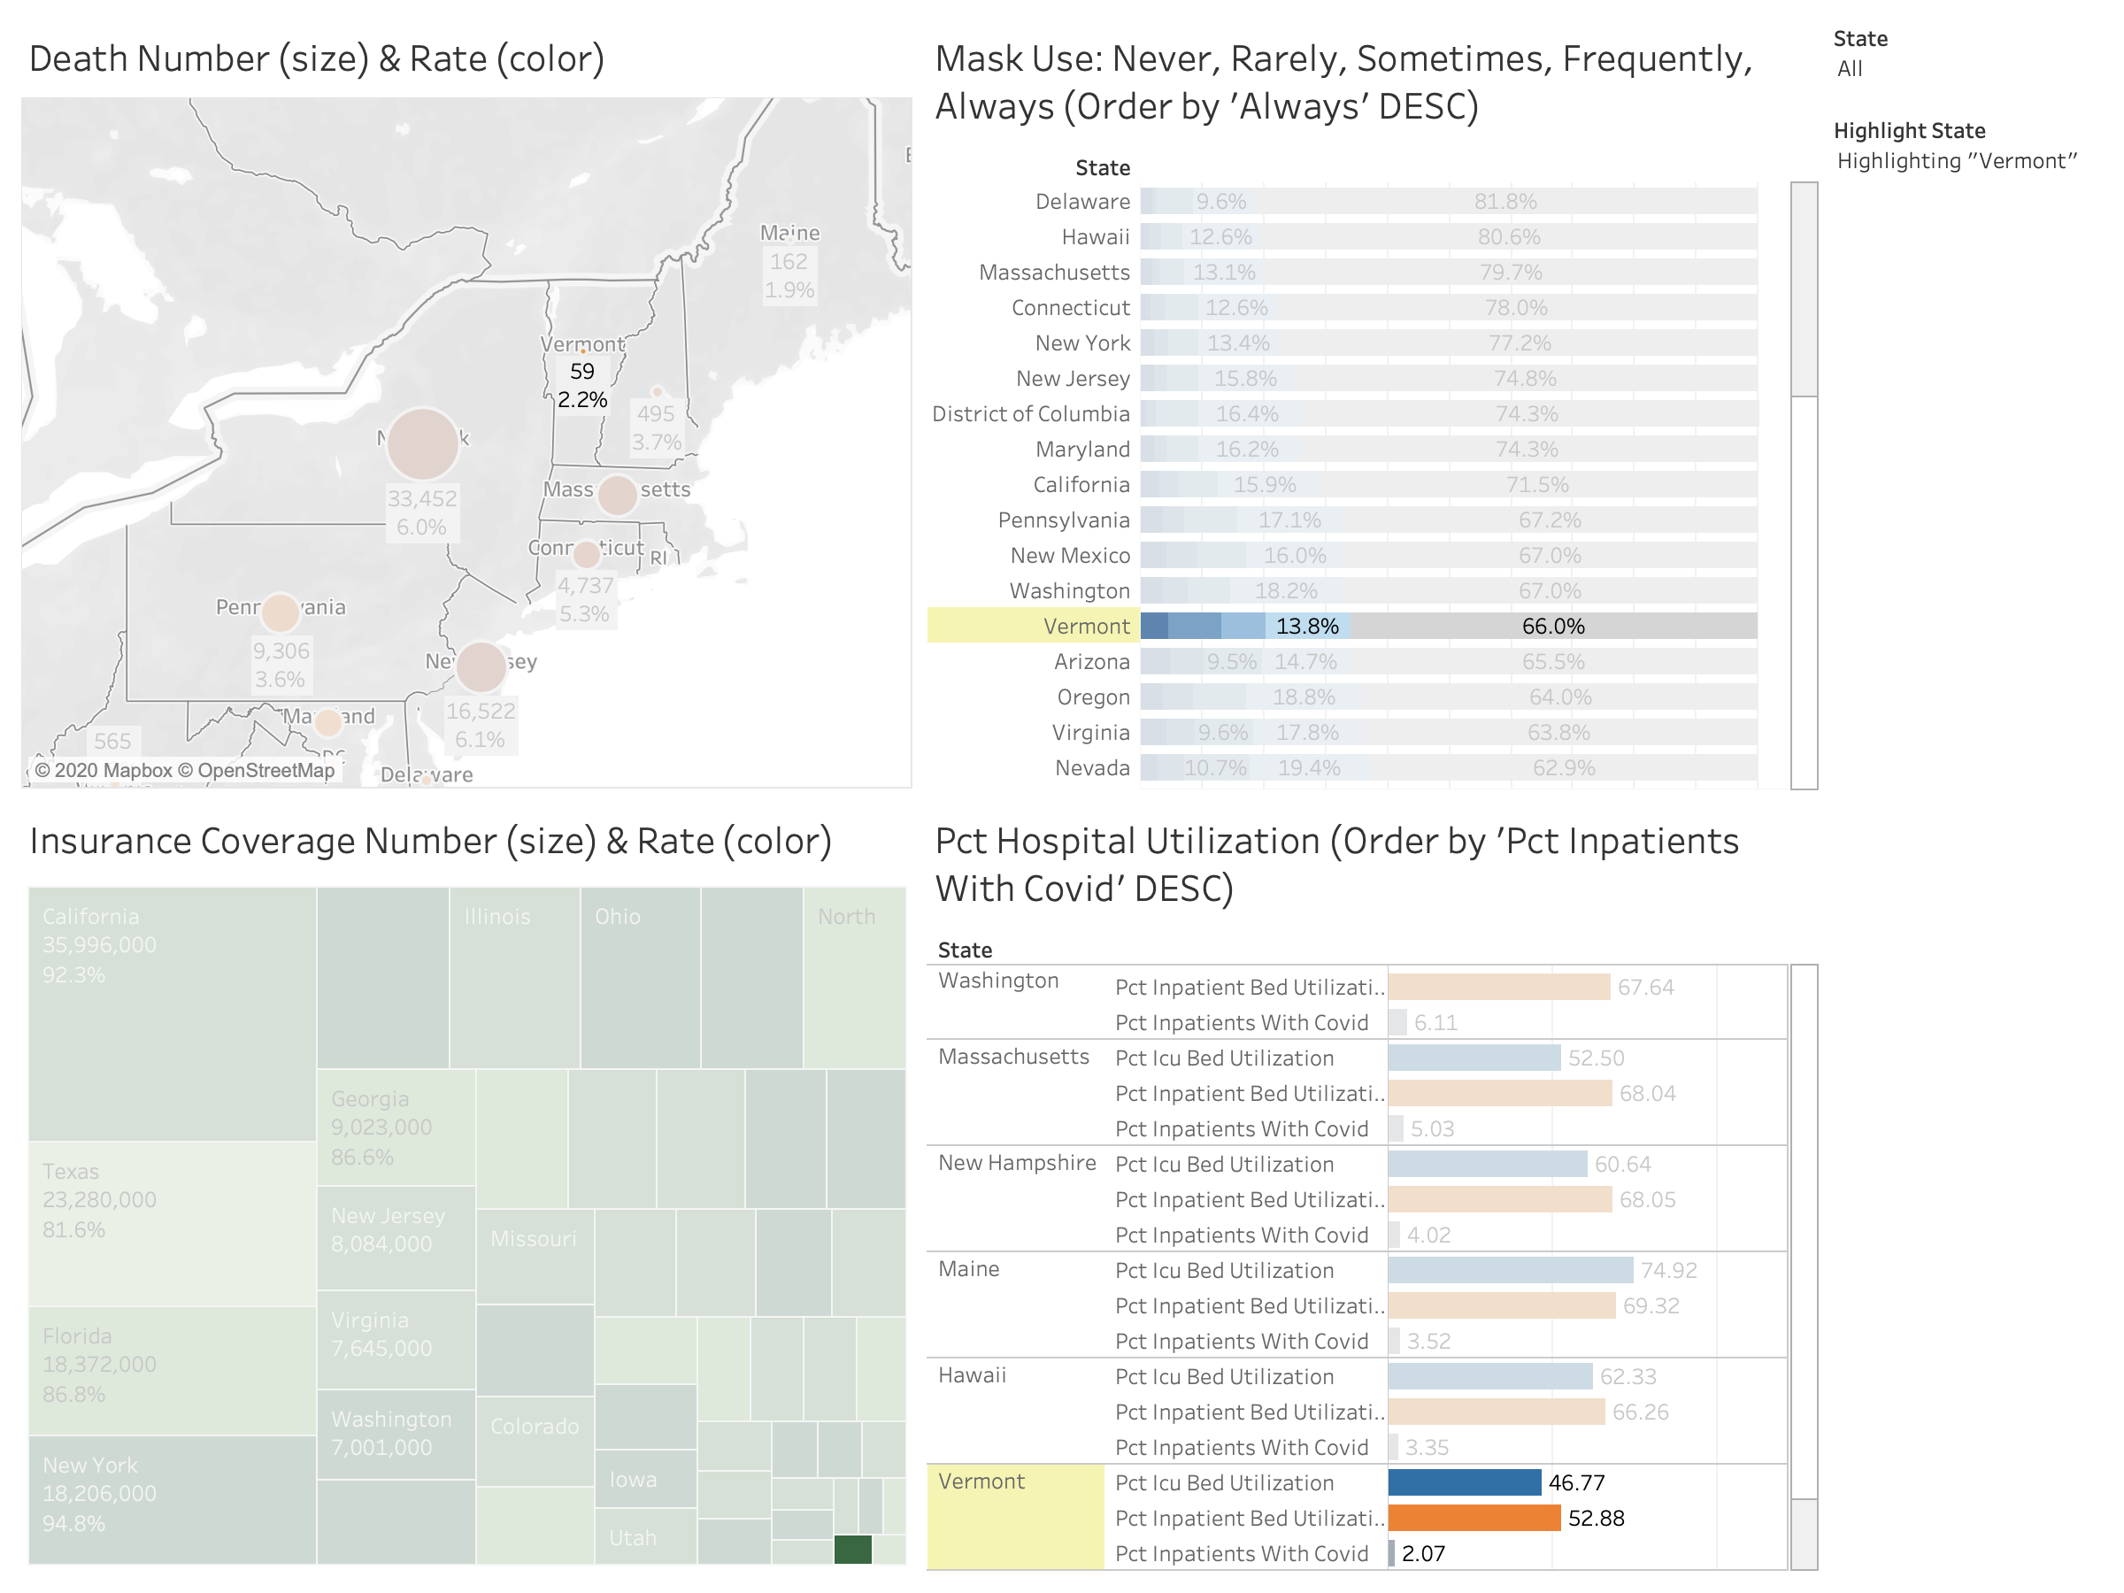
Case Study: Vermont
Executive Summary | Policy Insights | Design Considerations | Data Tools | Conclusions
Vermont is situated near many states hit hardest by the onset of coronavirus, yet it has emerged as a model for state response to the pandemic
Outcomes
One of the lowest case and death rates of all states
High rate of mask wearers chose always and few chose never
Policy Implementation
Quick to close and cautious to reopen
Staggered reopenings to monitor impact
Strong centralized health authority to issue advice and guidance

Slide 16
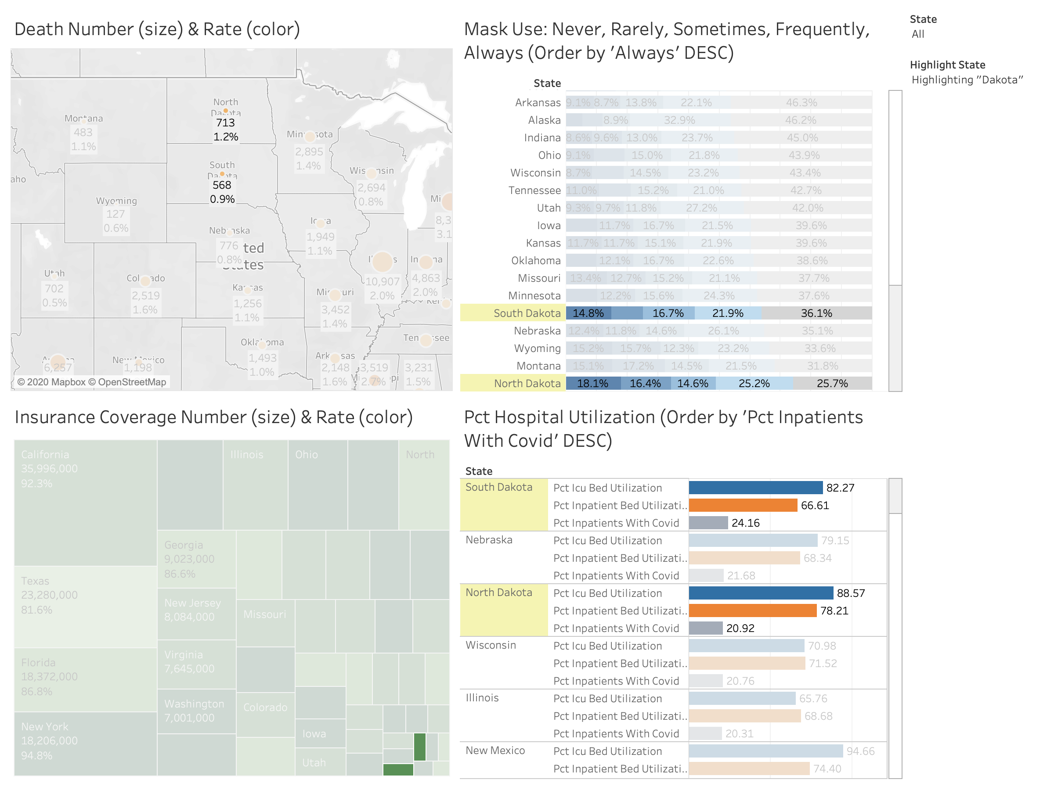
Case Study: The Dakotas
Executive Summary | Policy Insights | Design Considerations | Data Tools | Conclusions
Among North and South Dakotas neighbors, these two states are performing much worse and stand out as examples of poor policy implementation and response
Outcomes
Case rates are some of the highest in the country
Death rates are relatively low indicating lag and a recent surge in those states
Comparative Failures
North Dakota has the lowest proportion of ‘always’ and the highst of ‘never’ for mask wearing by wide margins
South Dakota has the highest percent of patients hospitalized with covid
Both states neglected policy and proactive measures leaving defenses crippled

Slide 17
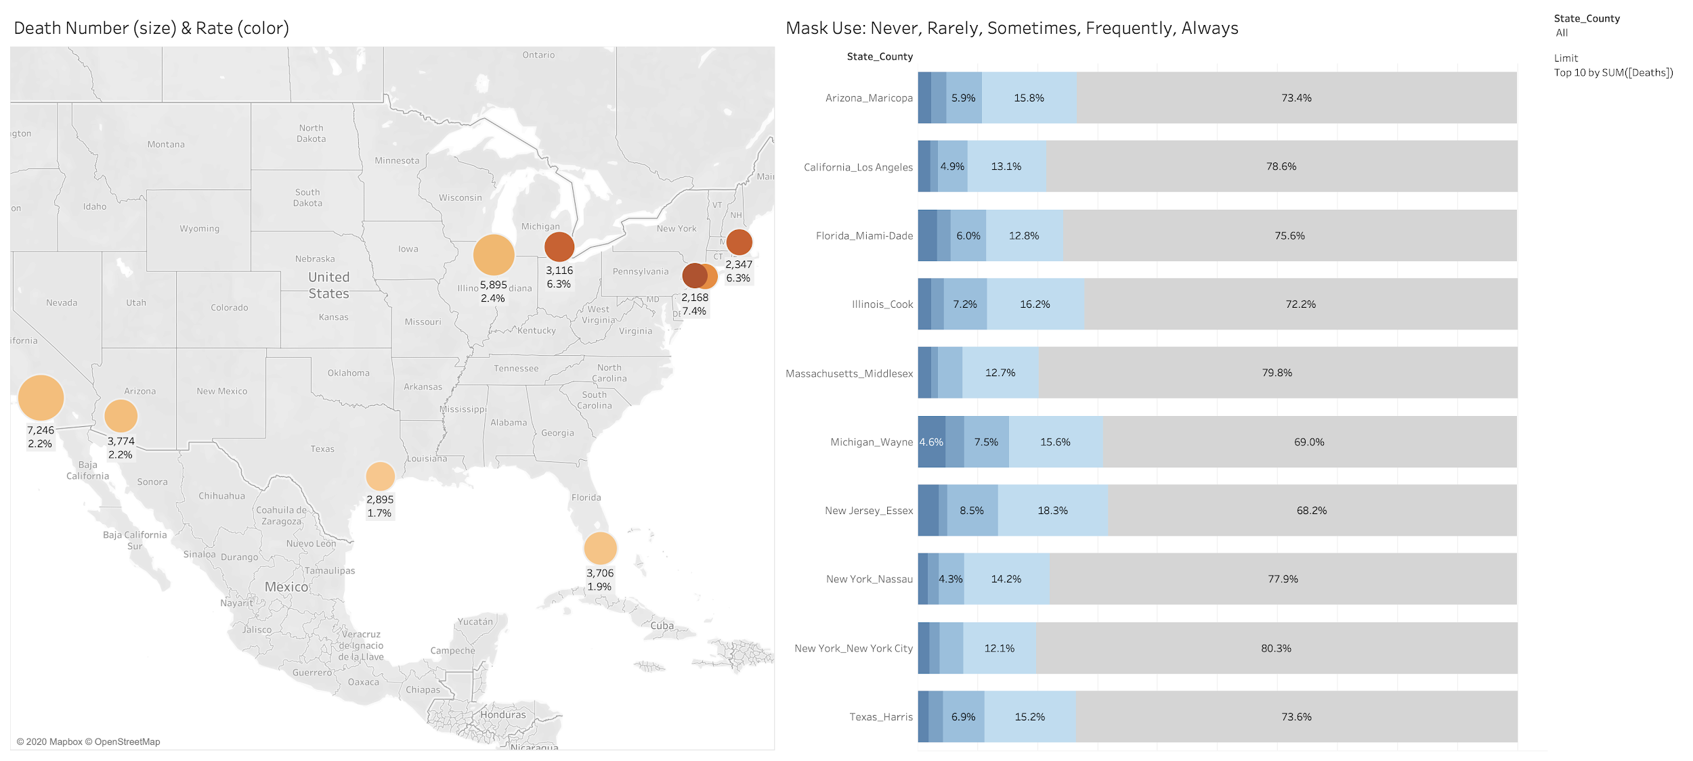
Tableau Dashboard: By County (Top 10 by Deaths)
Executive Summary | Policy Insights | Design Considerations | Data Tools | Conclusions

Slide 18
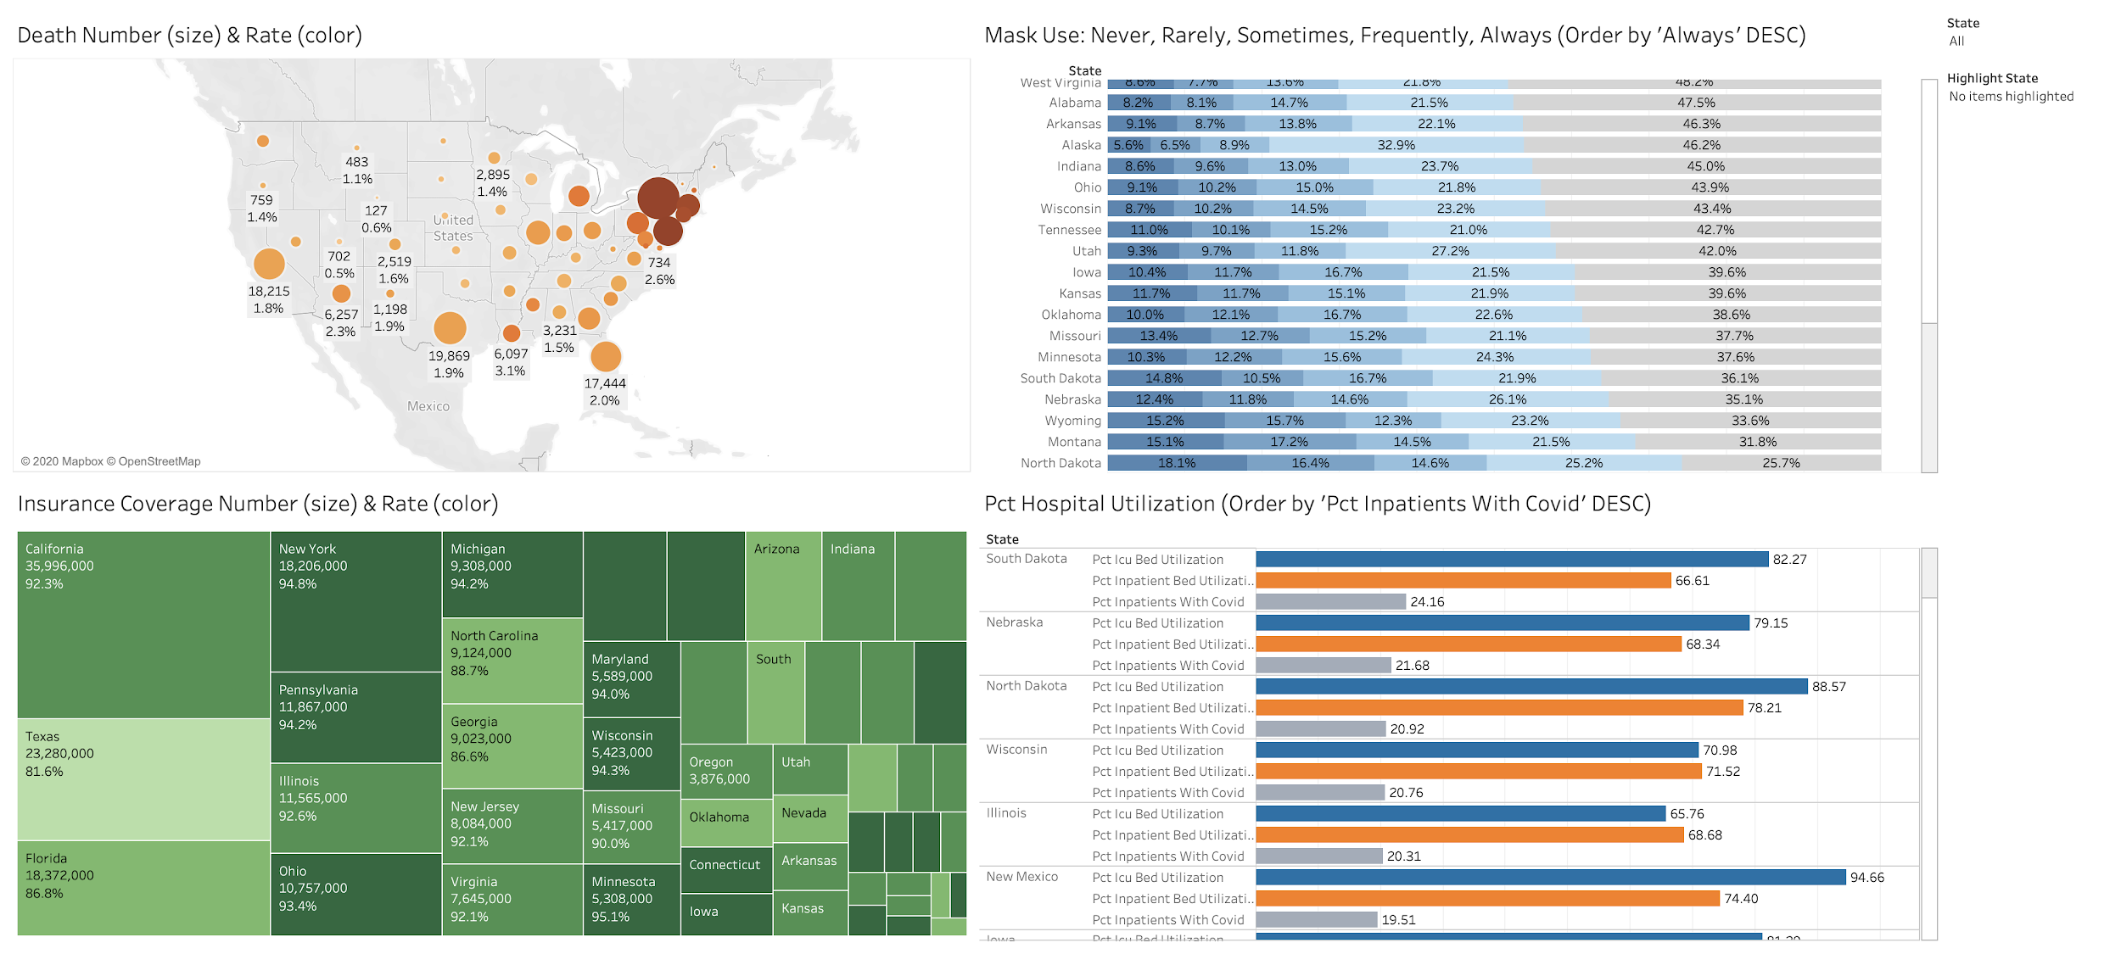
Tableau Dashboard: By State
Executive Summary | Policy Insights | Design Considerations | Data Tools | Conclusions

Slide 19
Conclusions
Executive Summary | Policy Insights | Design Considerations | Data Tools | Conclusions
Lessons Learned
Align information on collected data with all team members
Attribute definitions
Calculation procedures
Missing Data: the states of Idaho or Rhode Island not included
Consider presentation of Tableau dashboards
Hard to present statistics for all states & counties simultaneously
Future Scope
Perform analysis on live Covid data
Add stock data, industrial data and other metrics to get a comprehensive understanding Covid impacts
Assess time-dependent associations between policy and infection

Slide 20

Appendix: Our Team
Jaird Meyer
Elly Yang
Xiaojing Zhang
Mengyang Yu

Slide 21
Appendix: Reference
1
https://github.com/nytimes/covid-19-data/tree/master/mask-use
2
https://github.com/nytimes/covid-19-data/blob/master/live/us-states.csv
3
https://www.census.gov/data/tables/time-series/demo/popest/2010s-counties-total.html
https://www.census.gov/data/tables/time-series/demo/income-poverty/cps-hi/hi-01.html
4
https://www.census.gov/data/tables/time-series/demo/popest/2010s-counties-total.html
5
Slides template credited to Slidesgo and Freepik

